Slide 1
Mobile Platform Localization
Lecture 09-03
RBE500
Adj. Prof. J Center

Slide 2
Overview of Localization

Slide 3
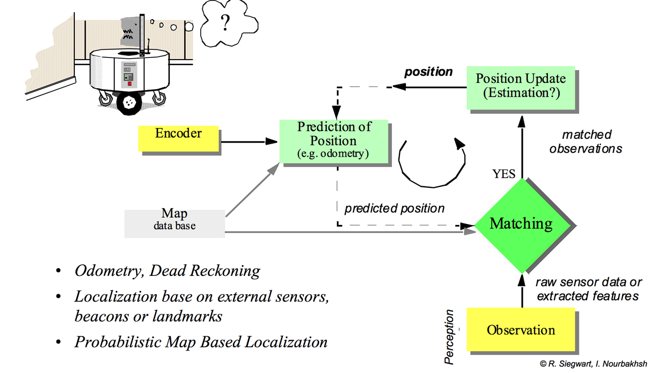
Localization – Where am I?

Slide 4
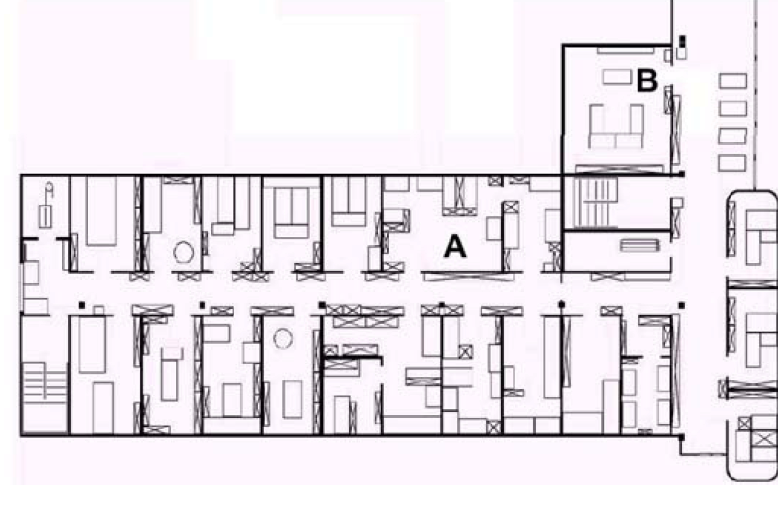
Navigating between A and B?
Two components to this task:
Navigation without hitting obstacles
Detection of goal location
Possible by just following the left wall
How to detect that the goal is reached?

Slide 5
How to navigate between A and B?
Map based navigation relies on a map
Assuming that the map is known, at every time step the robot has to localize itself in the map.
How?
If we know the start position, we can use wheel odometry or dead reckoning.

Slide 6
Dead Reckoning
Used to calculate a vehicle's estimated current position based on a previously determined position and estimated speeds over the elapsed time.
Errors accumulate over time
Unbounded growth in error
Often used to project location over short time periods.

Slide 7
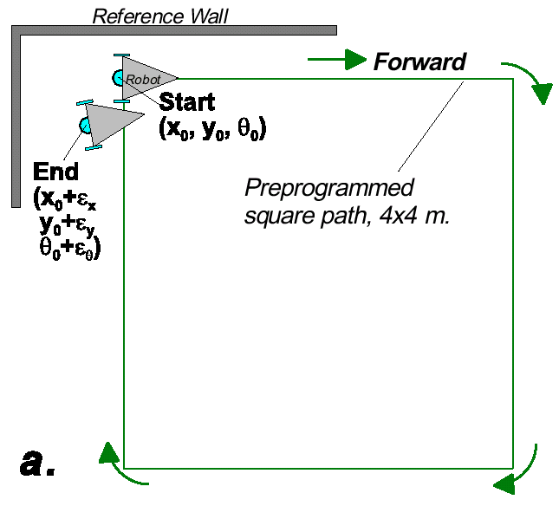
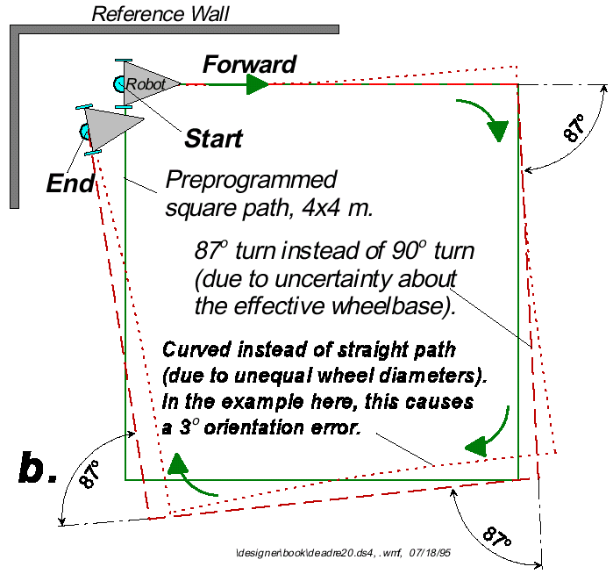
Dead reckoning – Error Growth

Slide 8
Odometry and Mapping
If we assume that our odometry is perfect, we could get something like this:

Slide 9

Odometry error sources
Deterministic errors can be eliminated by calibrating the system.
Non-Deterministic errors are random errors. They have to be described by error models and will always lead to uncertain position estimate.
Major Error Sources in Odometry:
Limited resolution during integration (time increments, measurement resolution) (non-deterministic)
Misalignment of the wheels (deterministic)
Unequal wheel diameter (deterministic)
Variation in the contact point of the wheel (non deterministic)
Unequal floor contact (slippage, non planar …) (non deterministic)

Slide 10
Localization
Two types of approaches:
Iconic : use raw sensor data directly. Match current sensor readings with what is expected (from maps, or past observations).
Feature-based : extract features of the environment, such as corners and doorways. Match current observations.
Typically, a combination of the two techniques will be used.

Slide 11
Grid-Based Localization and Mapping
Time
Initial Map
Global Map

Slide 12
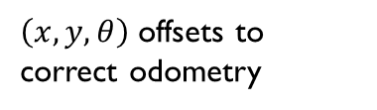
Grid-Based Localization and Mapping
Time
Sensor Data
Local Map
Global Map
Matching
Registration
$\left(x,y,θ\right)$ offsets to correct odometry

Slide 13
Grid-Based Localization and Mapping
Time
Local Map
Global Map
Matching
Registration
$\left(x,y,θ\right)$ offsets to correct odometry

Slide 14
Map Matching
X
Where am I?
Local Map
probabilities
Global Map

Slide 15
Map Matching
®
Where am I on the global map?
Local Map
obstacle
Global Map















®


…

®


…








…


















Examine different possible robot positions.

Slide 16
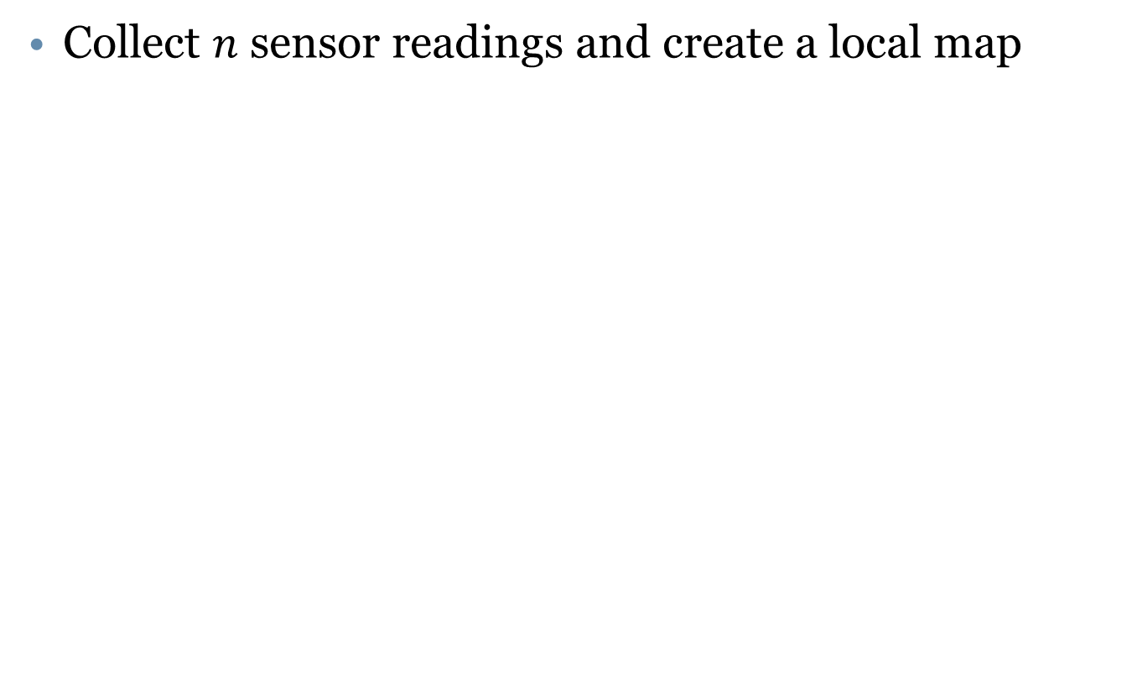
Matching and Registration
Collect $n$ sensor readings and create a local map

Slide 17
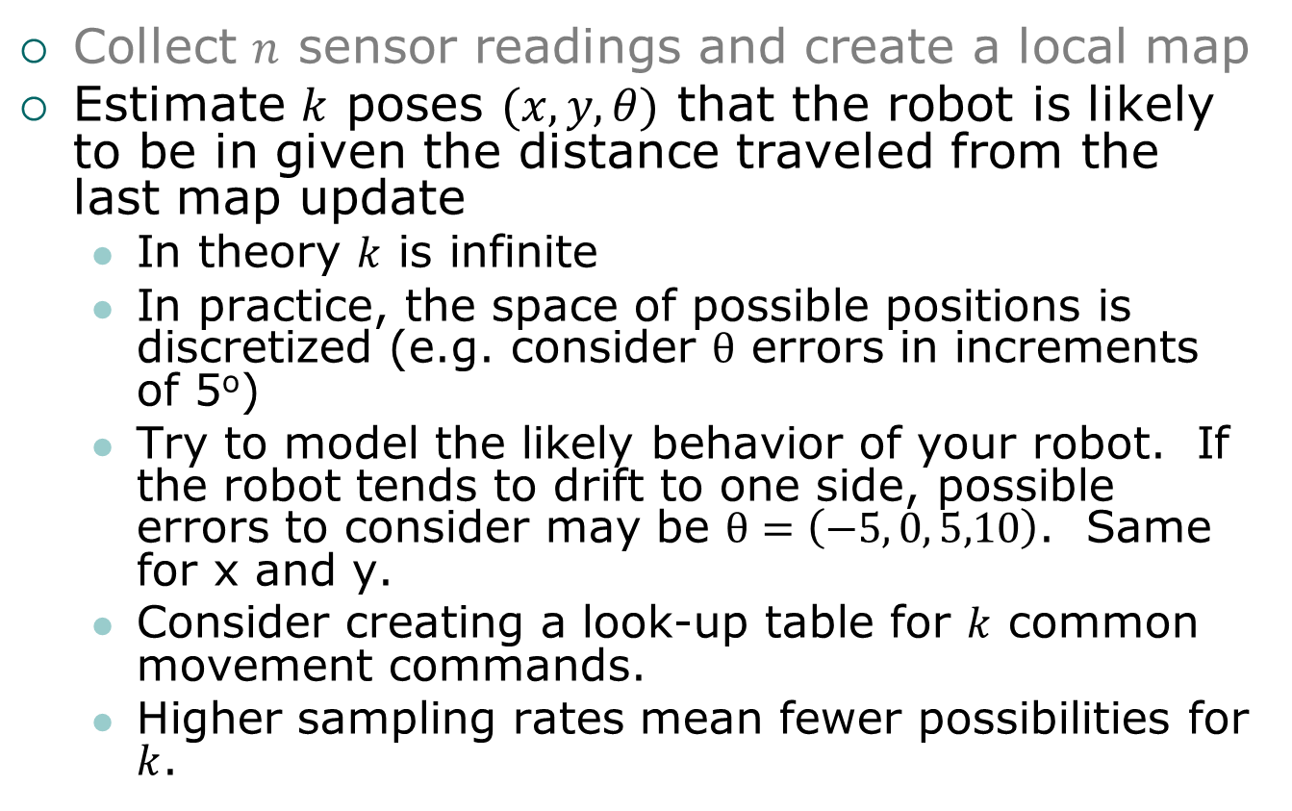
Matching and Registration
Collect $n$ sensor readings and create a local map
Estimate $k$ poses $(x,y,θ)$ that the robot is likely to be in given the distance traveled from the last map update
In theory $k$ is infinite
In practice, the space of possible positions is discretized (e.g. consider $θ$ errors in increments of 5º)
Try to model the likely behavior of your robot. If the robot tends to drift to one side, possible errors to consider may be $θ=\left(−5, 0, 5,10\right)$. Same for x and y.
Consider creating a look-up table for $k$ common movement commands.
Higher sampling rates mean fewer possibilities for $k$.

Slide 18
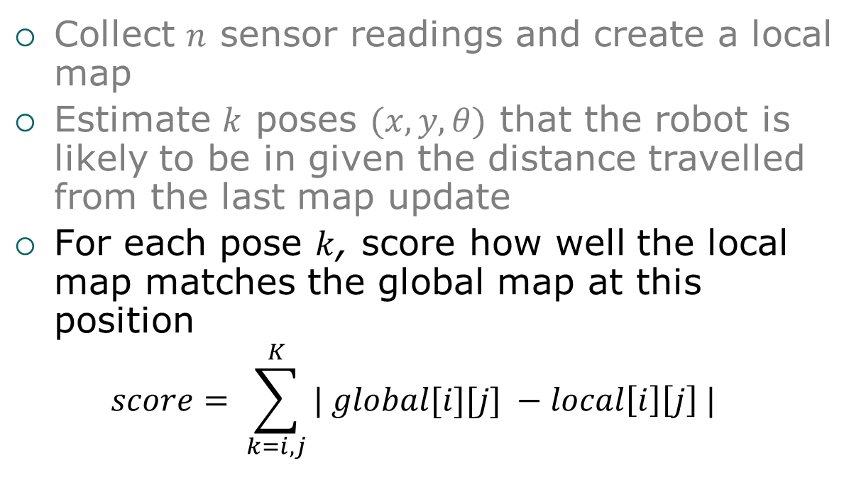
Matching and Registration
Collect $n$ sensor readings and create a local map
Estimate $k$ poses $(x,y,θ)$ that the robot is likely to be in given the distance travelled from the last map update
For each pose $k$, score how well the local map matches the global map at this position
$$score= \sum_{k=i,j}^{K}{| global[i][j]} −local\left[i\right]\left[j\right] |$$

Slide 19
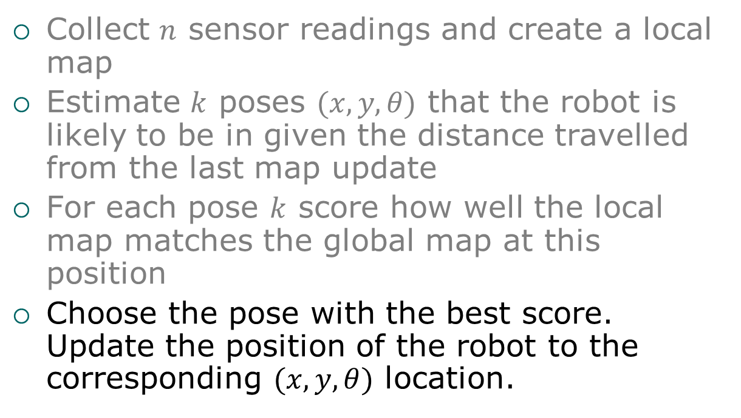
Matching and Registration
Collect $n$ sensor readings and create a local map
Estimate $k$ poses $(x,y,θ)$ that the robot is likely to be in given the distance travelled from the last map update
For each pose $k$ score how well the local map matches the global map at this position
Choose the pose with the best score. Update the position of the robot to the corresponding $(x,y,θ)$ location.

Slide 20
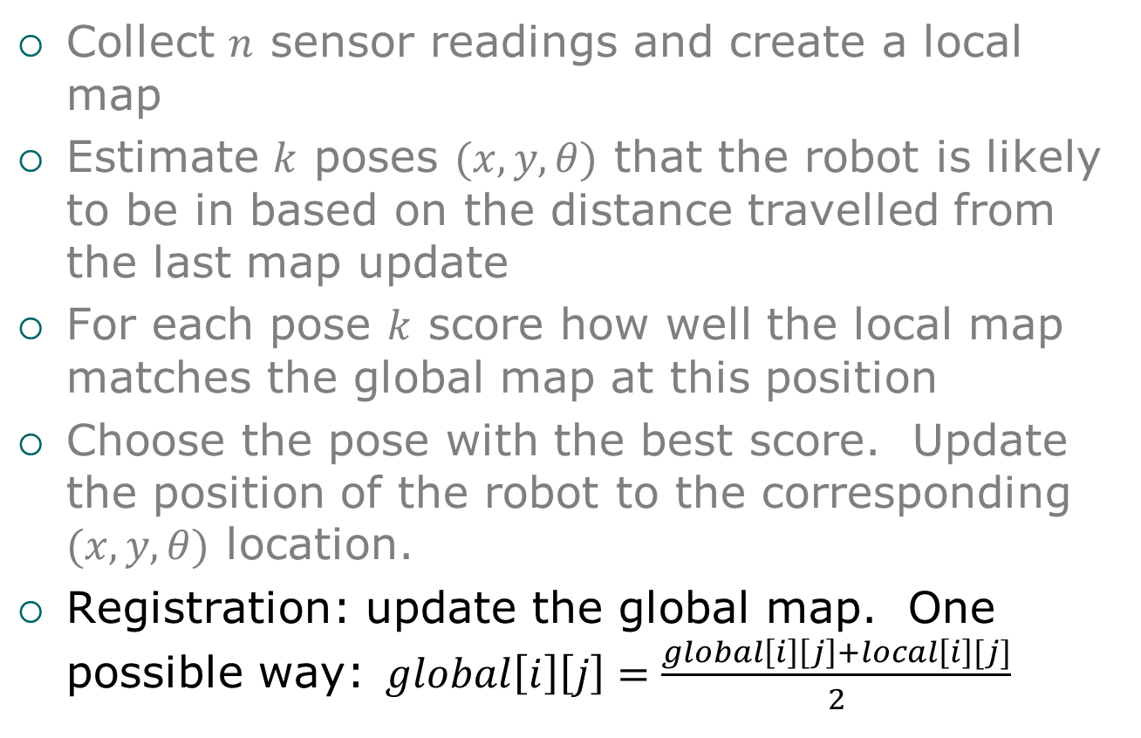
Matching and Registration
Collect $n$ sensor readings and create a local map
Estimate $k$ poses $(x,y,θ)$ that the robot is likely to be in based on the distance travelled from the last map update
For each pose $k$ score how well the local map matches the global map at this position
Choose the pose with the best score. Update the position of the robot to the corresponding $(x,y,θ)$ location.
Registration: update the global map. One possible way:$global\left[i\right]\left[j\right]=\frac{global\left[i\right]\left[j\right]+local\left[i\right][j]}{2}$

Slide 21
Continuous Localization and Mapping
registration
global map
match and score
sensor data
construct local map
local map
“best” pose
encoder data
pose estimation
k possible poses
Encoder compensation

Slide 22
A Brief Recap…
So we now have a practical example showing:
Applying a heuristic “goodness of fit” test to evaluate the likelihood that a proposed solution is correct.
Using the results of that test to:
Infer likely robot location and orientation
Potential corrections to sensor data to reconcile measured observations with expected observations.
This basic approach has multiple applications.

Slide 23
Some Comments
Computational complexity of this technique is related to grid size.
Quadratic growth in search space as grid size is reduced.
Additional growth as angular resolution in increased.
Even worse in 3D!

Slide 24
Introduction to Image Feature Extraction

Slide 25
Introduction to Image Feature Extraction
Harris Corner Detection
SIFT – Scale Invariant Feature Transformation
SURF – Speeded-Up Robust Features
Deep Learning

Slide 26
References
Harris Corner Detection
https://courses.cs.washington.edu/.../HarrisDetector.ppt
SIFT
Original Paper
https://www.cse.unr.edu/~bebis/CS491Y/Papers/Lowe04.pdf
Presentation
cs.haifa.ac.il/hagit/courses/seminars/visionTopics/Presentations/Lecture01_SIFT.ppt
Video Lecture
https://www.youtube.com/watch?v=NPcMS49V5hg

